Slide 1




PROJECT REPORT
AI-Based Lost & Found System
Revolutionizing campus recovery with computer vision and intelligent matching.
Anushka Rathour
12200884 | B. Tech. CS &AI

Slide 2

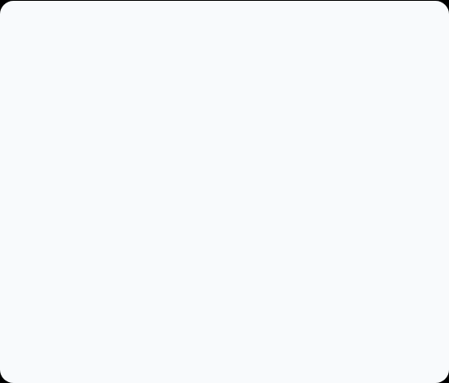



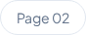
The Campus Problem
"Have you seen my keys?"
In a bustling university environment, traditional lost and found methods are broken. They rely on:
01
Physical Notice Boards Limited reach, cluttered, and often ignored.
02
Unverified WhatsApp Groups Spam-filled and lacks privacy or security.
03
Manual Verification No way to prove ownership effectively.

Slide 3





System Objectives
Centralization
Visual AI
Security
Replacing scattered manual logs with a single, unified cloud database accessible 24/7.
Integrating CLIP ViT-L/14 to allow users to search by image similarity, not just text.
Ensuring data integrity through student ID verification and restricted admin controls.

Slide 4



Technology Stack
Backend Engine
Frontend & UI
Python FastAPI High-speed async API handling.
HTML5 / CSS3 Semantic structure & styling.
Sentence Transformers Running the CLIP Model logic.
Vanilla JavaScript Dynamic interactions & AJAX.
SQLite Reliable, serverless storage.
Jinja2 Server-side template rendering.

Slide 5
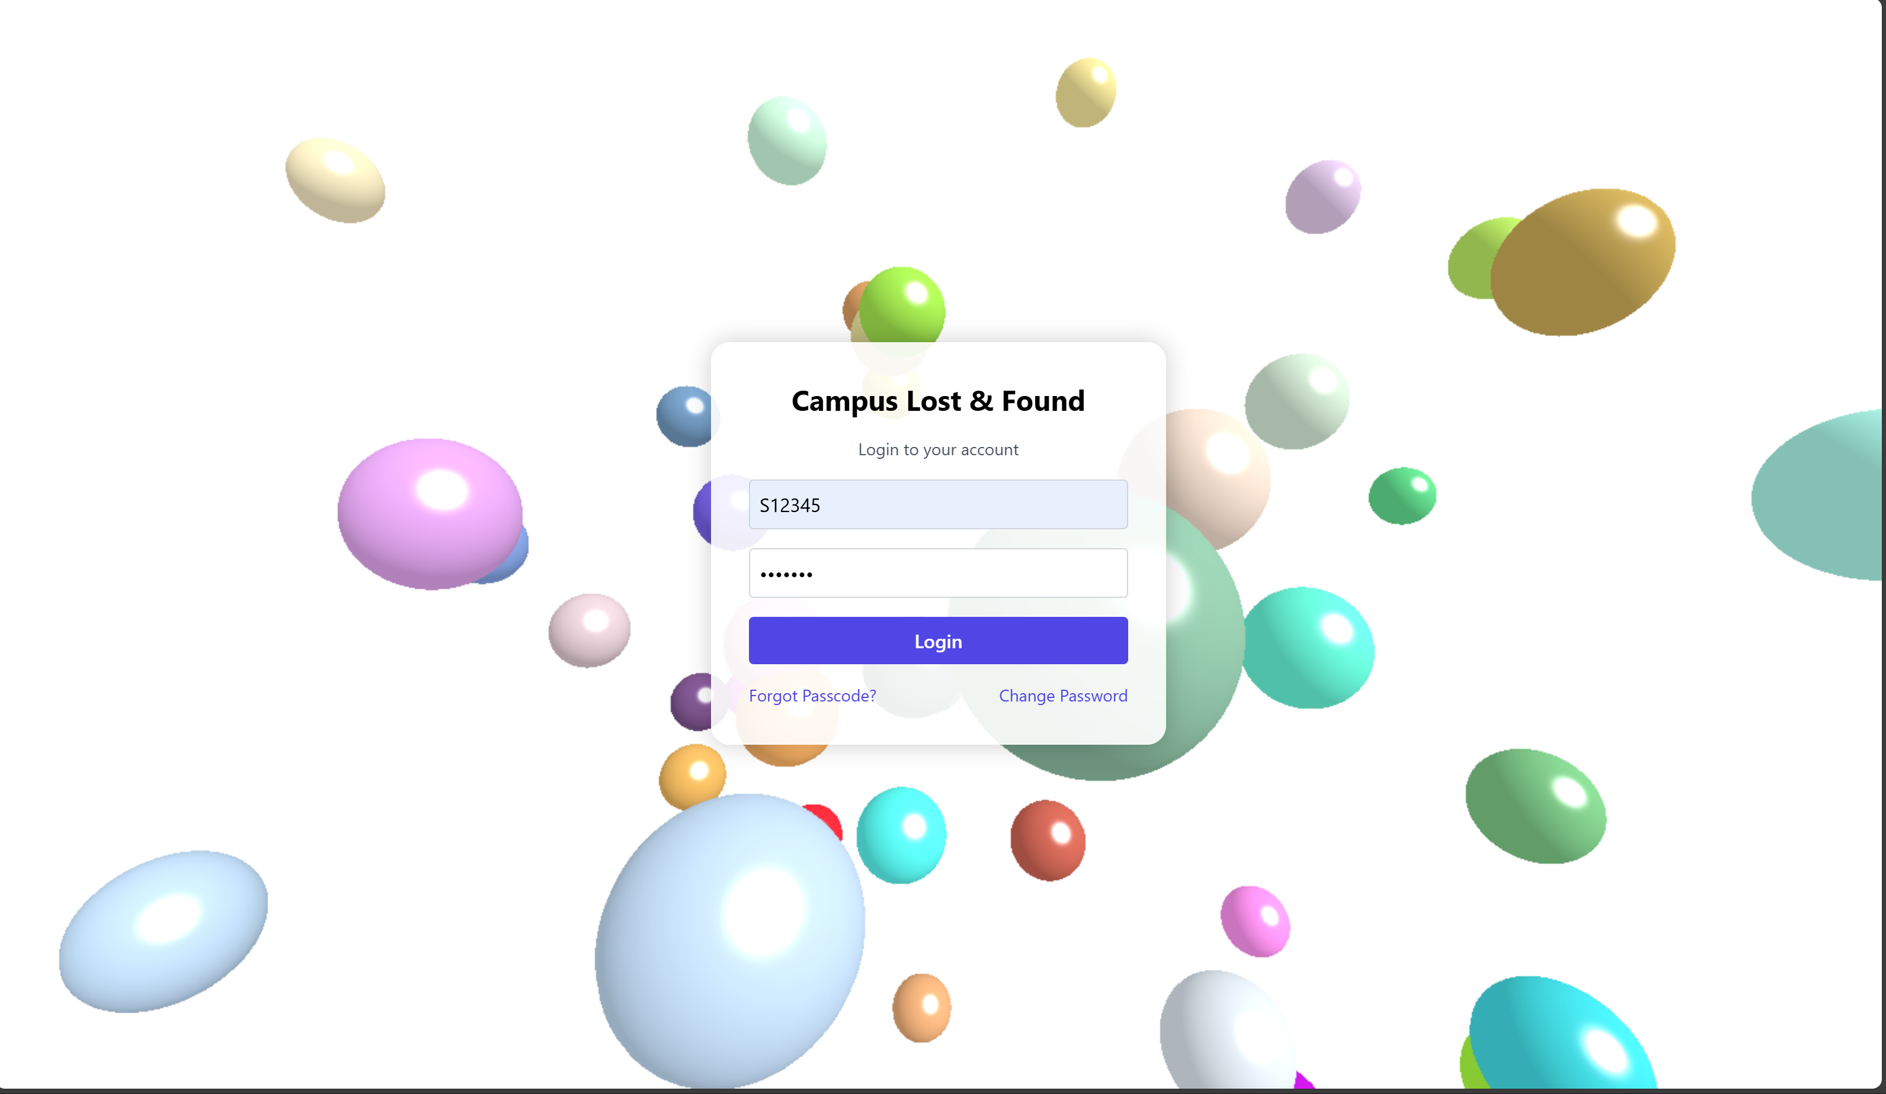


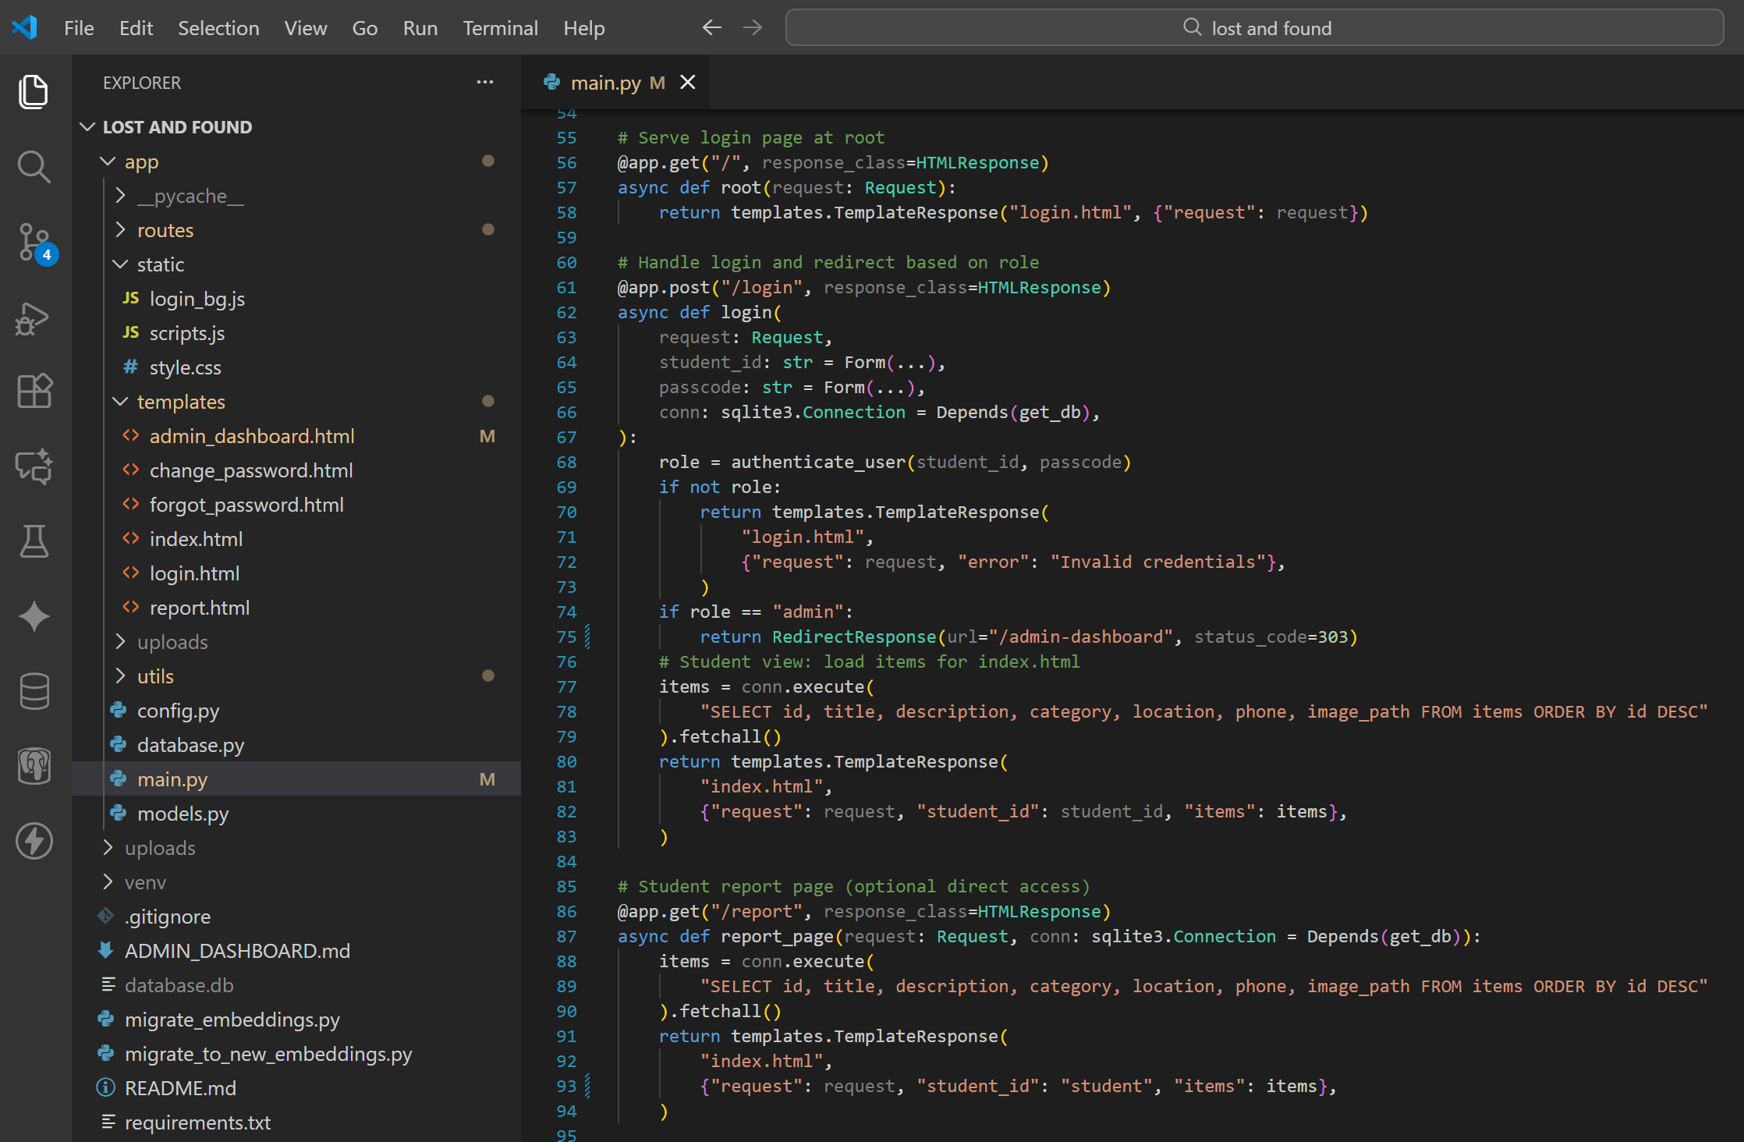





System Implementation
localhost:8000/dashboard
main.py

Slide 6
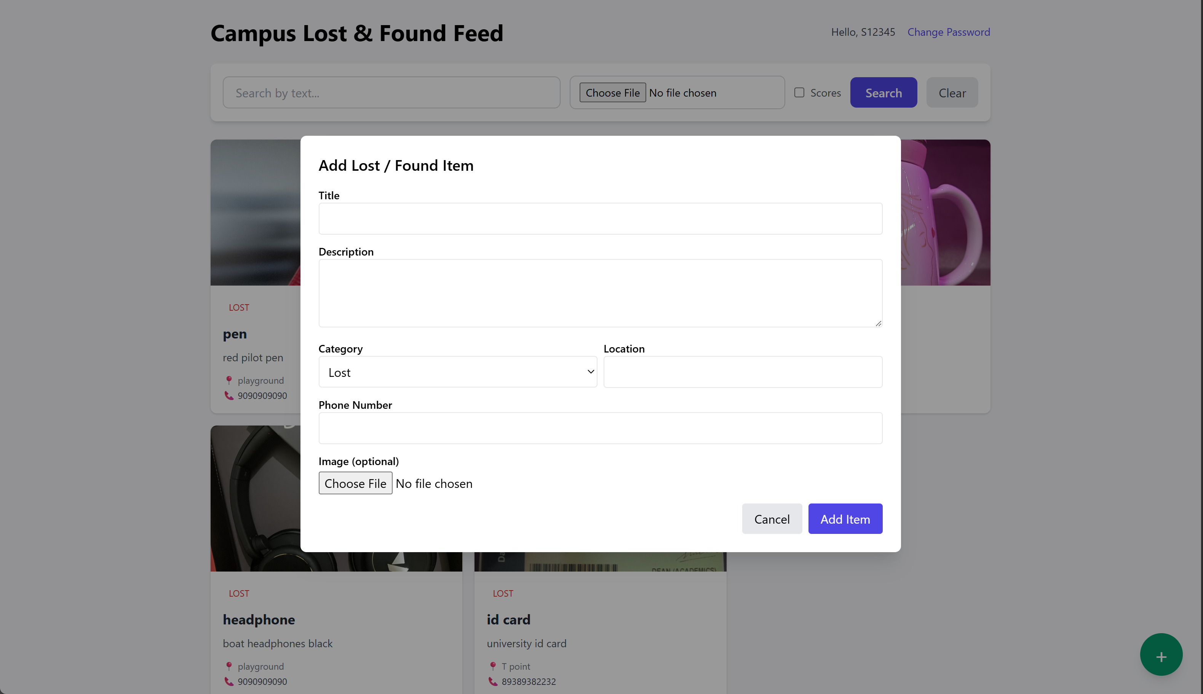
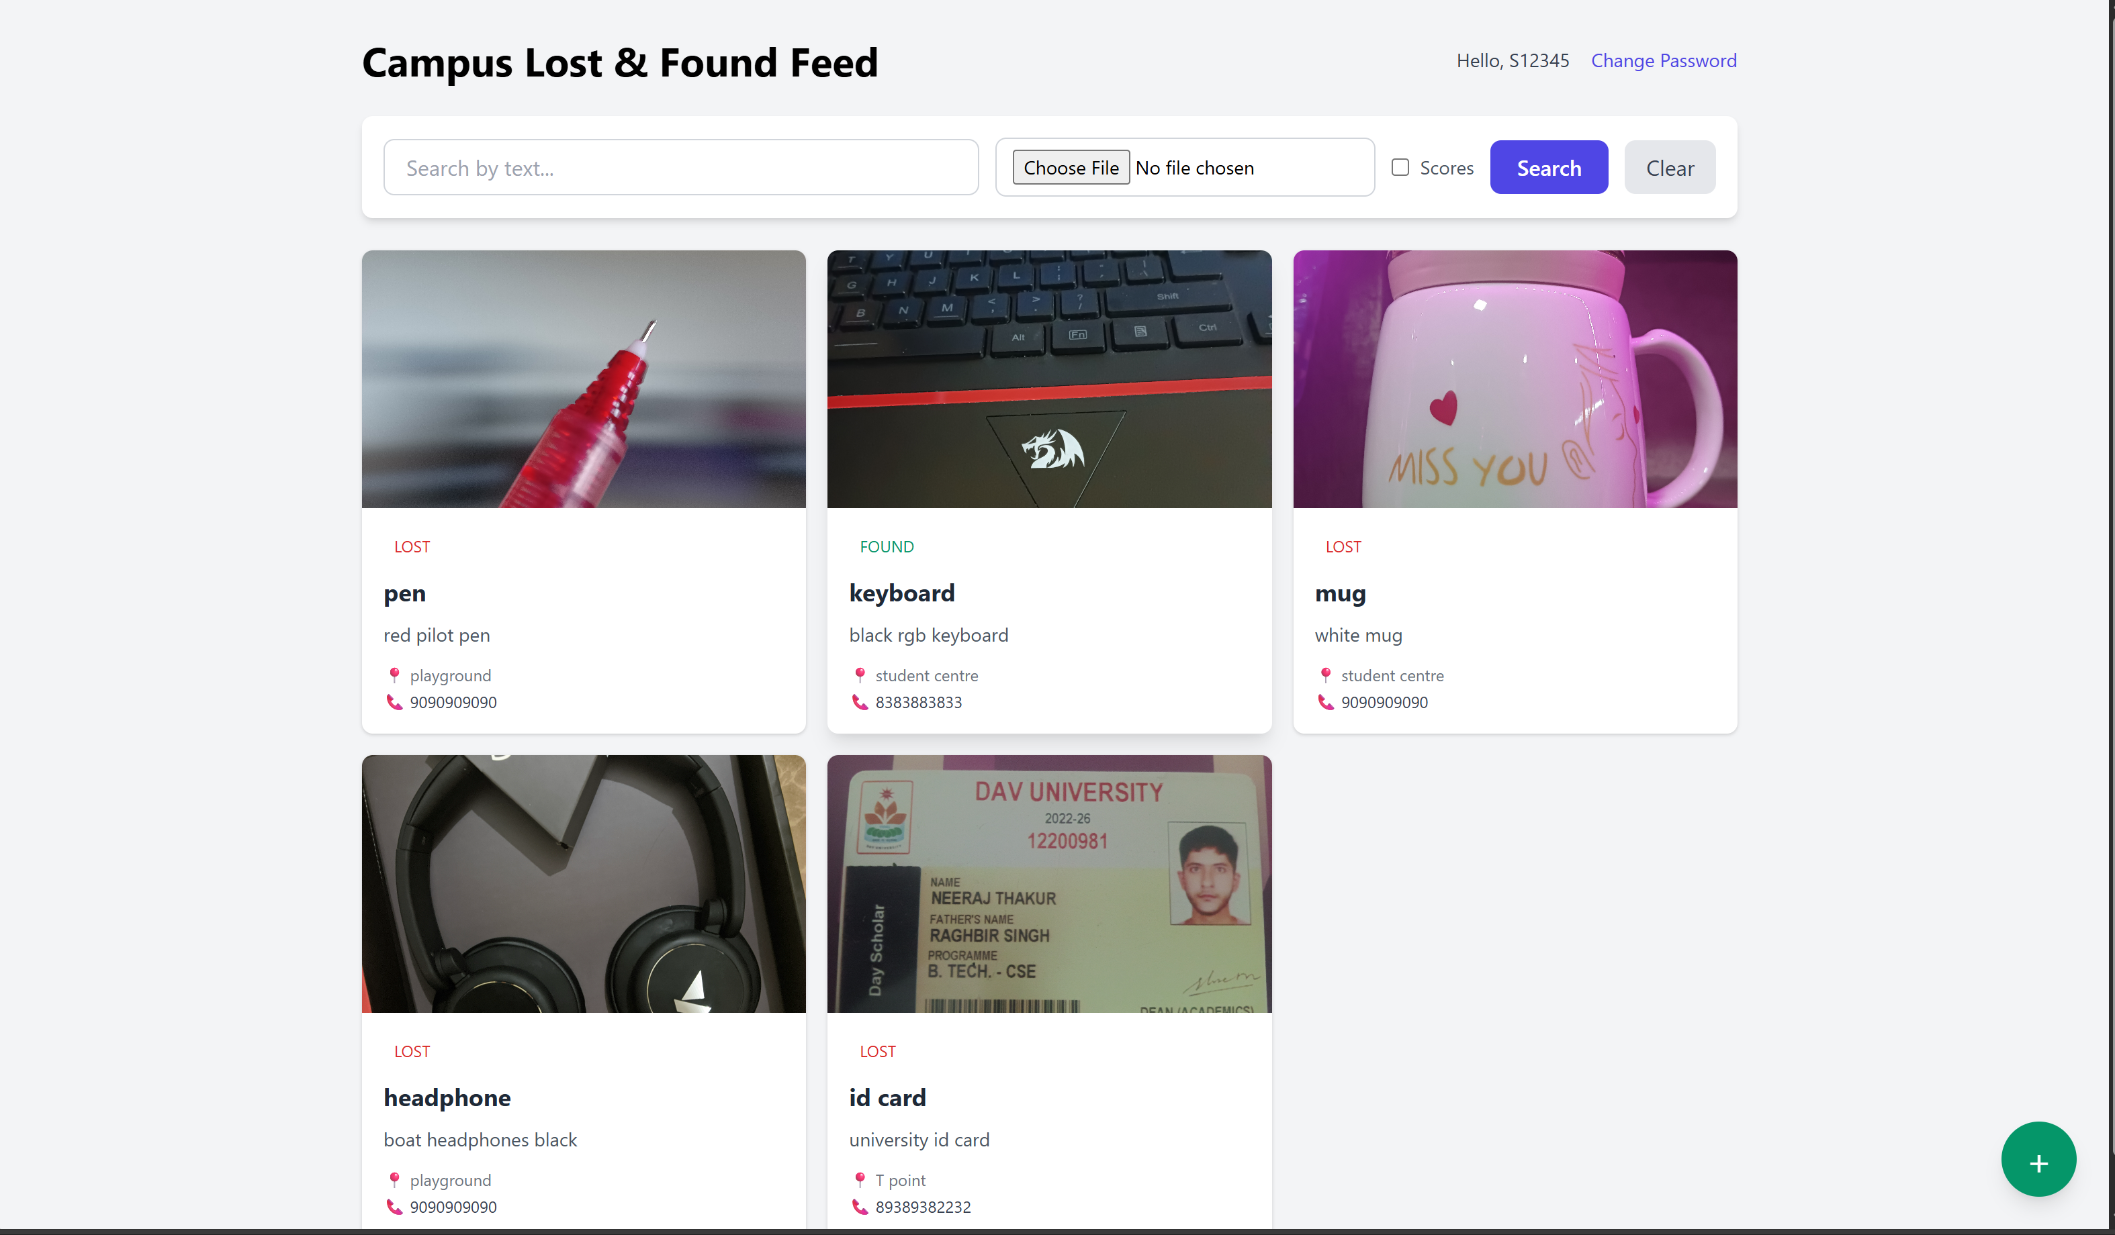
System Implementation

Slide 7
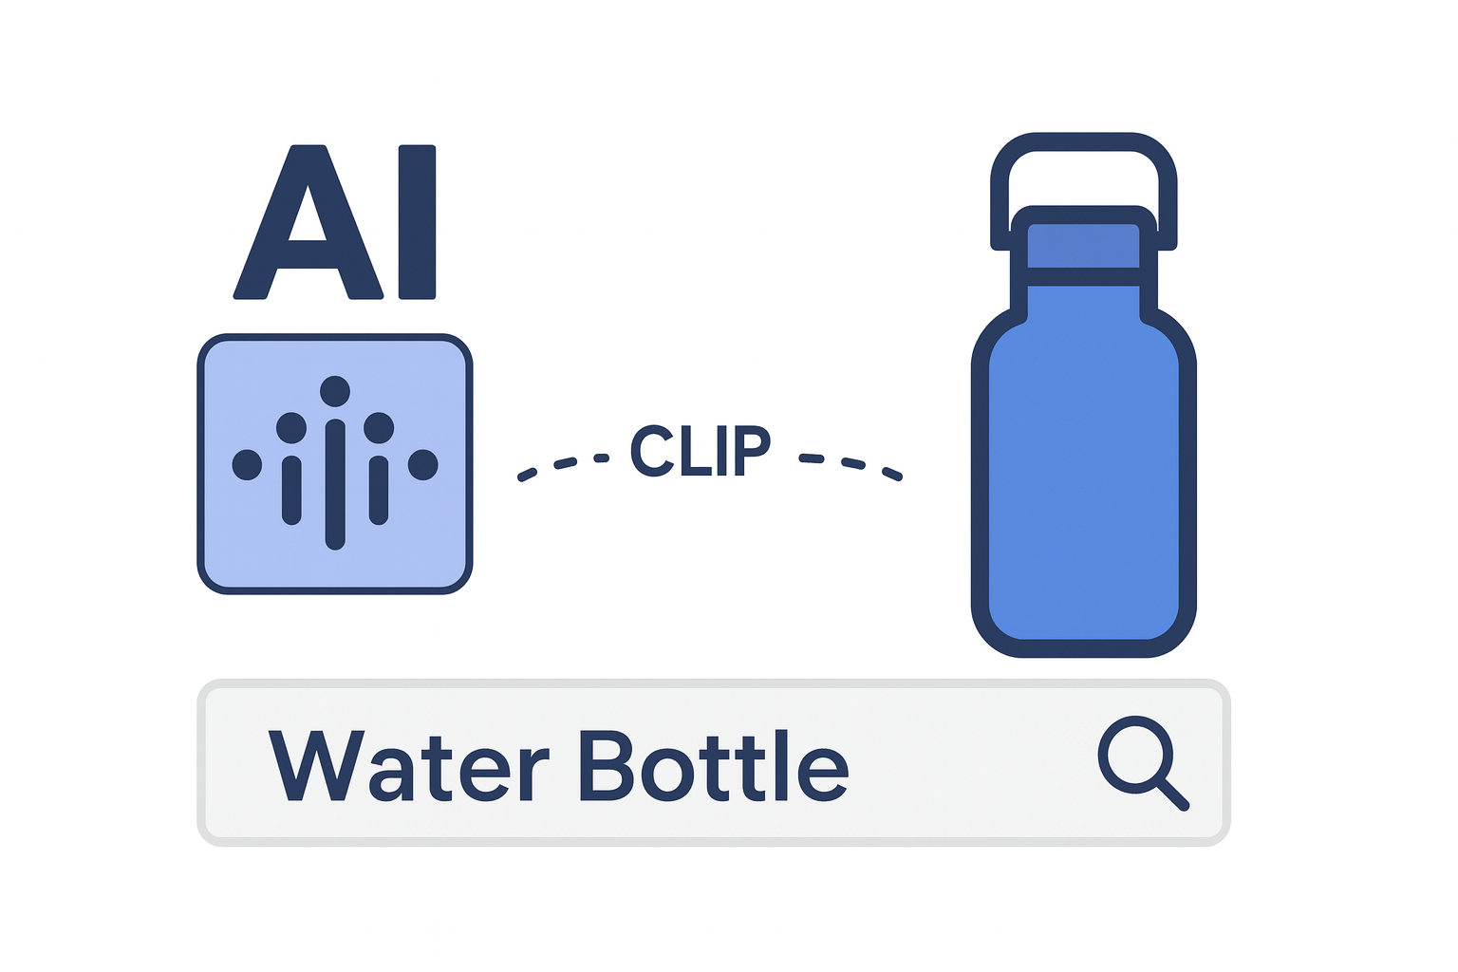



The Brain: CLIP ViT-L/14
Zero-Shot Learning
We utilize OpenAI's CLIP (Contrastive Language-Image Pre-training). It maps images and text to the same vector space.
Why it matters: If you lose a "Blue Hydroflask" but search for "Water Bottle", the AI understands they are visually related, even without exact keywords.

Slide 8


How It Works
01
02
03
04
Upload
Process
Vectorize
Match
User uploads photo & details.
FastAPI validates input.
CLIP creates embeddings.
Cosine similarity search.

Slide 9



Key Distinctions
Real-World AI
Optimized Architecture
Moving beyond theory. This project bridges the gap between academic Deep Learning concepts and practical, everyday utility tools.
By using Transfer Learning (pre-trained weights), we achieve high accuracy without the need for massive computational power or expensive GPUs.

Slide 10




Future Scope
Mobile App
Auto Alerts
Multi-Campus
Developing a React Native application for camera-first reporting.
SMS/Email notifications when a potential match is found.
Scaling the database to PostgreSQL for larger deployments.

Slide 11

Q&A
Thank you for your attention.
Anushka Rathour
|
B Tech CS & AI
12200884

